Slide 1
Client Side Scripting
Data

Slide 2
Data
When you want to create a program, you find that the program must access and manipulate data because data is at the root of all systems
You collect data, manipulate data, store data, retrieve data, display data etc
Data is found in different forms
Programming languages usually categorize information into different types, and treat each type in a different way.
In JavaScript, the three most basic types of data are number, string, and Boolean.

Slide 3
Number Type
Numbers are used for counting and calculating
The Number type is one of the primitive types defined in JavaScript
Numbers are very important in JavaScript programming:
You can use numbers to keep track of how many times a visitor has visited a web page
to specify the exact pixel position of an item on a web page
or to determine how many products a visitor wants to order.

Slide 4
Number Type
Numerical data comes in two forms:
Whole numbers, such as 145, which are also known as integers. These numbers can be positive or negative and can span a very wide range in JavaScript: –9007199254740992 to 9007199254740992
Fractional numbers, such as 1.234, which are also known as floating-point numbers. Like integers, they can be positive or negative, and they also have a massive range
In JavaScript, all numeric values are internally represented as floating point values.
Calculations with whole numbers (also called integers) that fit in 52 bits are guaranteed to always be precise. Unfortunately, calculations with fractional numbers are generally not
Like π (pi) cannot be precisely expressed by a finite amount of decimal digits
Many numbers lose some precision
It is important to treat fractional digital numbers as approximations, not as precise values

Slide 5
Number Type Special Values
The number type supports the following special values:
NaN - Not a number indicator. Performing any mathematical operation with NaN will produce a result of NaN
Infinity - Represents positive infinity when your value exceeds 1.7976931348623157E + 10308
-Infinity - Represents negative infinity when your value exceeds -1.7976931348623157E + 10308
undefined - No value has been assigned

Slide 6
Number Type Arithmetic
We need numbers to perform arithmetic operations
Many arithmetic operations, such as addition, subtraction, multiplication, and division, perform an operation on two numeric values to produce a resultant numeric value
In JavaScript, you might write an expression to do something like this:
7 + 3 * 8
This is an expression with operands and operators
The plus sign (+) and multiplication sign (*) are operators.
The numbers are operands.

Slide 7
Number Type Operator Precedence
In the previous expression (7 + 3 * 8 ), you do not add 7 and 3 to get 10 and then multiply 10 by 8 to get 80
JavaScript supports operator precedence, the assignment of a precedence, or priority, to each operator.
In this expression, the multiplication sign has a higher precedence than the addition sign, so 3 is first multiplied by 8 to give 24, and then 7 is added to 24 to get 31, which is different from the previous result of 80.
The addition sign (+) and subtraction sign (–) have the same precedence. The multiplication sign (*) and division sign (/) have the same precedence, which is higher than the addition and subtraction signs.
If you are working with an expression in which multiple operators have the same precedence, you just apply the operators from left to right.
You can use brackets to indicate the order of precedence.
Brackets have the highest precedence, so the expression within the brackets will be executed first.

Slide 8
Strings
To display a name, a sentence, or any series of letters, you need to use strings
A string is just a series of characters (letters and other symbols) enclosed inside of quote marks.
'Welcome!'
"You are here"
A string’s opening quote mark tells the JavaScript interpreter that what follows is a string
The interpreter accepts the symbols literally, rather than trying to interpret the string as anything special to JavaScript like a command / code
When the interpreter encounters the final quote mark, it understands that it has reached the end of the string

Slide 9
Strings
You can use:
Double quote marks "hello world" or
Single quote marks 'hello world'
You need to use the same type of quote mark at the beginning and end of the string:
"this is not right'
The above string isn’t valid since it begins with a double-quote and ends with a single-quote
To pop-up an alert box with the message Warning, warning!
alert('Warning, warning!'); or
alert("Warning, warning!");

Slide 10
Strings
If you need to embed double or single quotes into the string, you can use the backslash (\) character to escape the single or double quote, as shown in the following example:
'The doctor said "I\'m pleased to announce that it\'s a girl!" '
"The doctor said \"I'm pleased to announce that it's a girl!\" "
Other common escape sequences are \t for a tab and \n for a new line. You can also use \uHHHH where HHHH is a 4-digit hexadecimal code for a unicode string.
The plus sign is used to represent string concatenation:
'Hickory Dickory Dock.' + "The mouse ran up the clock." + 'The clock struck one...'

Slide 11
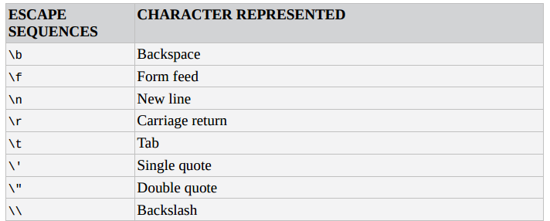
Strings Escape Sequences

Slide 12
Unary Operators
Not all operators are symbols; some are written as words.
One example is the typeof operator, which produces a string value naming the type of the value you give it:
typeof 4.5 → "number"
typeof "x" → "string"
The previous operators we saw all operated on two values; typeof takes only one.
There are two types of operators:
Binary Operators: use two values are called e.g. 5 + 2
Unary Operators: take one value e.g. typeof 2
The minus operator can be used both as a binary operator and a unary operator: - (10 - 2) → -8

Slide 13
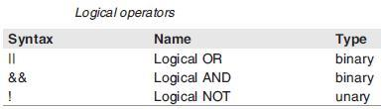
Boolean
Whereas numbers and strings offer almost limitless variations, the Boolean data type is simple
It is either one of two values: true or false
Although you can use these values directly, it’s more common to produce a true or false value by comparing two values:
10 < 9
20 > 3
'Apples' != 'Oranges‘

Slide 14

Practice
Access Moodle and work out Worksheet 4

Slide 15
References
Johnson, G. (2013). Programming in HTML5 with Javascript and CSS3. United States of America: Microsoft Press.
McPeak, J. (2015). Beginning JavaScript, 5th Edition (5 ed.). Wrox.
Haverbeke, M. (2011). Eloquent JavaScript: A Modern Introduction to Programming. (S. Yang, Ed.) San Francisco: William Pollock.
McFarland, D. S. (2014). JavaScript & jQuery (3 ed.). United States of America: O’Reilly Media, Inc.

